Slide 1
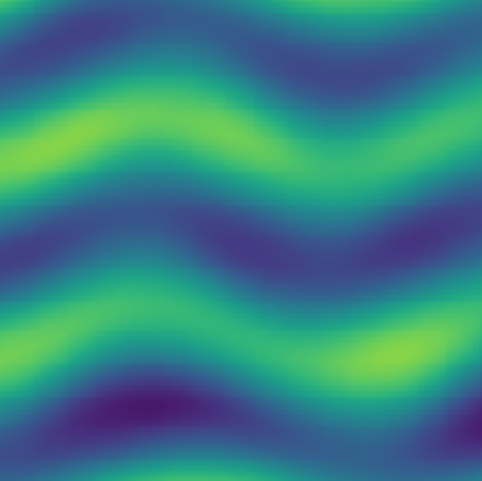
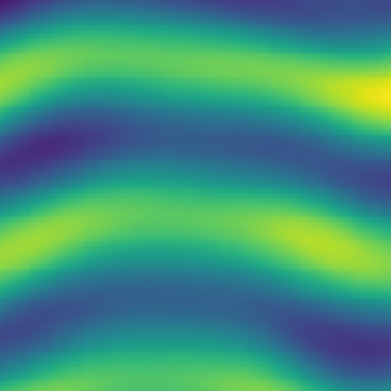




Input (50 x 50 patches)
Prediction (50 x 50 patches)
Convolutions
$$t−1$$
$t$+20
$$t−20$$
$$t$$

